Slide 1
Optical Bypass
Ari Torkilsson Johannesen (s233913)

Slide 2
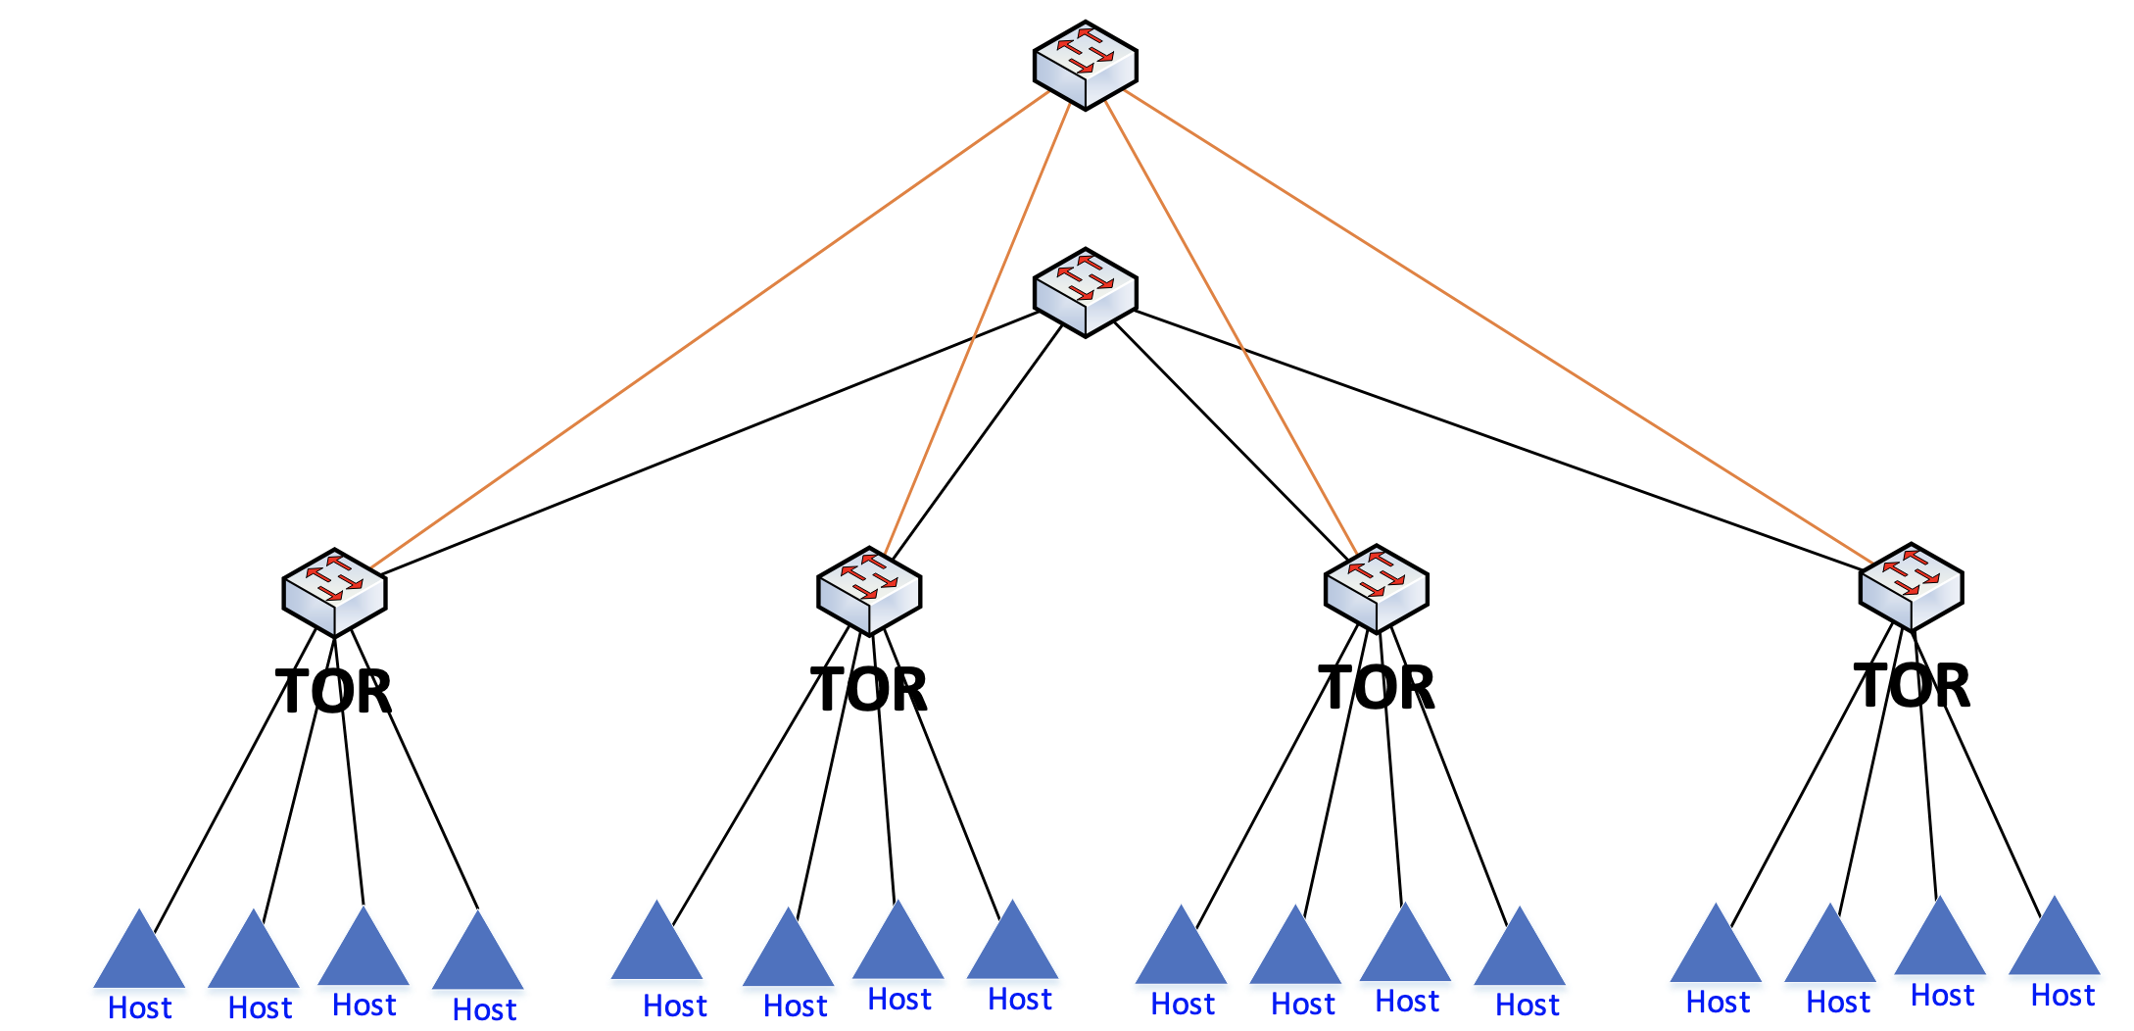
Network topology and terminology
Leaf-spine network topology
1 x Optical Spine
1 x Electrical spine
4 x Leafs (TOR)
4 x Hosts per leaf

Slide 3
Intra-leaf communication
Hxx
1st digit refers to the leaf switch (0-indexed).
2nd digit refers to the host.
“Local traffic should never leave the TOR”.
Similar forwarding logic as org.onosproject.fwd (L2):
Selector: In-port, source MAC, destination MAC
Treatment: Out-port (connecting to destination MAC)

Slide 4
Inter-leaf communcation
“Remote traffic that meets pre-defined criteria should be sent (if possible) through the optical bypass”.
All other inter-leaf traffic via electrical spine.
Forwarding logic based on L3/L4.
RTT = 4 x link latency
Electric: 10 Mbps, 100 ms (~400 ms RTT)
Optical: 1 Gbps, 0.01 ms (~0.04 ms RTT)

Slide 5
Practical demonstration
Local traffic never leaves the leaf/TOR.
iPerf (TCP/5001) traffic should be sent via optical bypass, if port-pair is available.
All other inter-leaf traffic is sent via electrical spine.

